Slide 1
CROP PLANNING
Sprint - 01

Slide 2
Progress of sprint - 01
Analysis of seasonal fruits and vegetables
Collecting dataset for seasonal fruits
Analysis of daily price report
Analysis of weekly price report

Slide 3
Analysis the indian seasonal fruits and vegetables
Fruits
Apple
Grapes
Mango
Papaya
Pineapple
Jackfruit
Vegetables
Bitter Gourd
Gabbage
Cauliflower
Okra
Onion
Peas
Potato
Tomato
Reference : https://www.allthatgrows.in/blogs/posts/vegetable-growing-season-chart-india

Slide 4
Collecting dataset for seasonal fruits
Collects the daily price report of Pineapple for Kerala, Alappuzha district, Alappuzha market from Jan 01 2012 to June 31 2022.
Reference : https://agmarknet.gov.in/SearchCmmMkt.aspx?Tx_Commodity=20&Tx_State=KL&Tx_District=16&Tx_Market=128&DateFrom=01-Jan-2012&DateTo=31-Dec-2012&Fr_Date=01-Jan-2012&To_Date=31-Dec-2012&Tx_Trend=0&Tx_CommodityHead=Mango&Tx_StateHead=Kerala&Tx_DistrictHead=Alappuzha&Tx_MarketHead=Alappuzha

Slide 5
Analysis of daily price report
Number of data collected from daily price report for:
2012 | 253
2013 | 236
2014 | 232
2015 | 210
2016 | 174
2017 | 90
2018 | 128
2019 | 152
2020 | 141
2021 | 143

Slide 6
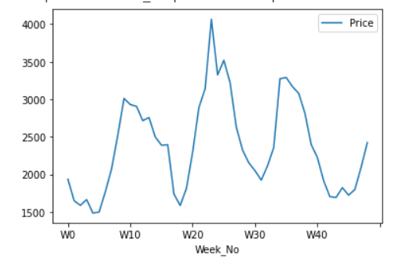
Graphical analysis of daily price report for 2012

Slide 7
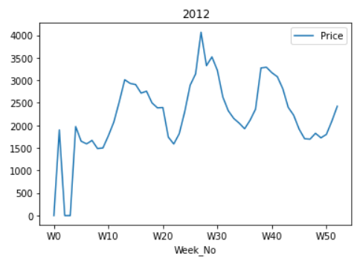
Analysis of weekly price report
Due to the lack of data for daily analysis, found the average price for a week of a year and create weekly price report and analyse it.
Missing dates were added and for those dates price is assumed as 0.

Slide 8
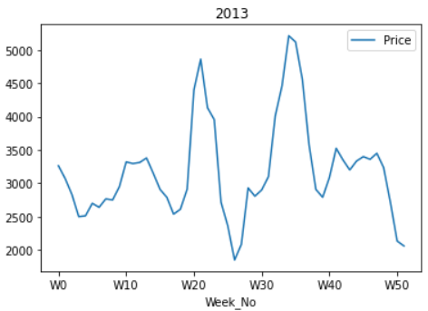
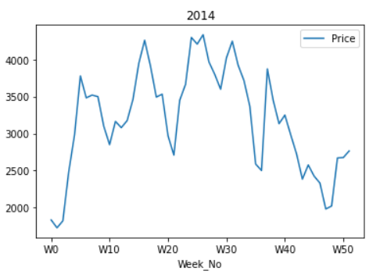

Slide 9
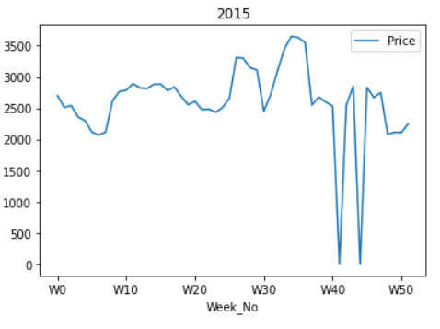

Slide 10
Thank
you

